Slide 1
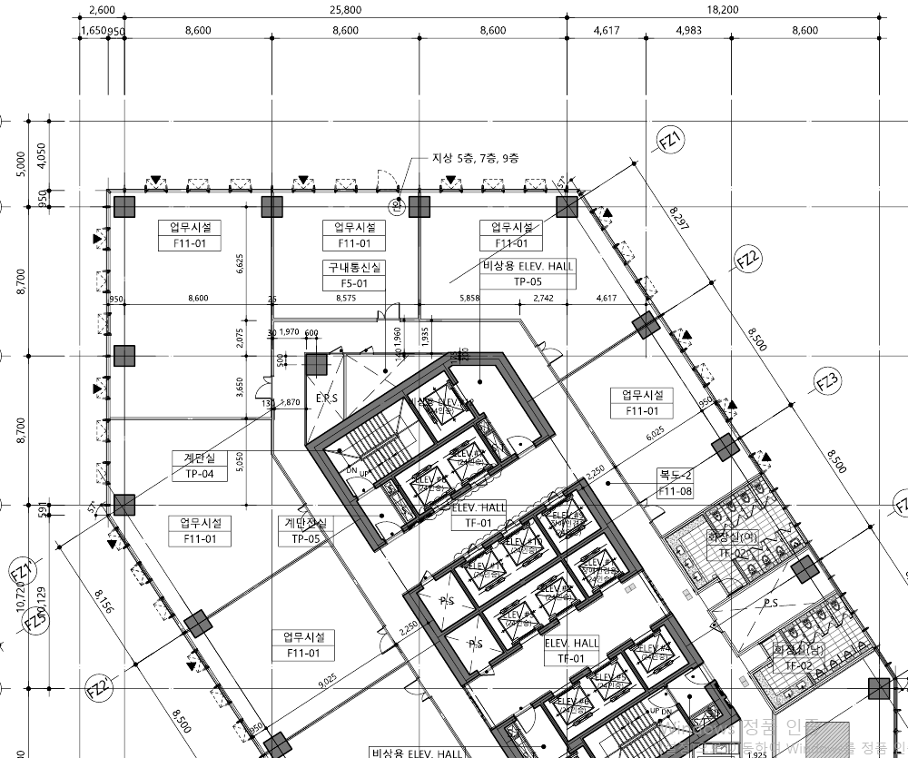
3,000
3,000
6,500

